Slide 1
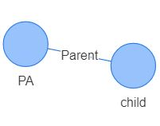
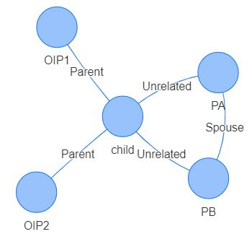
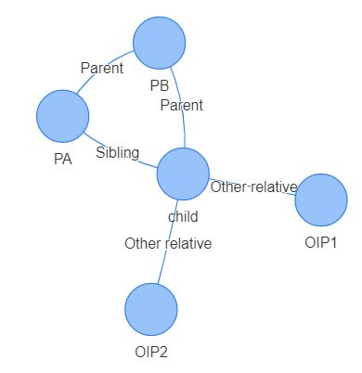
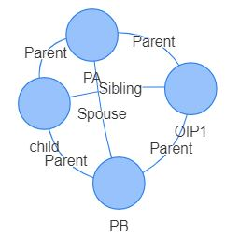

Developing Family Relationship Networks for the
Virginia Department of Social Services
Megan Grondine (Virginia Tech), Daniel Liden (University of Minnesota, Twin Cities), Alexa Nosal (Virginia Tech)
SDAL: Brian Goode, Aaron Schroeder
Sponsor: Jeff Price : Research Analyst at the Virginia Department of Social Services
Project Overview
“How many distinct individuals and families did we serve today?” - Jeff Price, VDSS Research and Planning
Project Title: Unsupervised Learning Data Analysis to Develop Network Visualizations of Family Relationships
Problem Statement: Depending on the program, and the way the program identifies, tracks, and manages people within the program, each program may define ‘household’ and ‘family’ differently
Task: Create proof of concept using data from the National Incidence Study of Child Abuse and Neglect (NIS) that will easily translate for VDSS datasets in the future
1 DATA EXPLORATION
VDSS stakeholder definitions of “family” and “nonfamily” vary significantly. Some are articulate with detail, while others are more vague. Stakeholders have different needs for defining “family.” This creates an issue for the department as a whole as they try to identify who they are serving.
Stakeholders:
Childcare Subsidy
  “Any individual(s), adult(s), and/or children related by blood, marriage, adoption or expression of kinship who function as a family unit.”
TANF
  No definition of “family.” However, "assistance unit" means "those persons who must participate together as a family unit." Allows child to receive benefits from non-family caretakers through “Family Cap” provision.
Child Protective Services, Child Support Enforcement, Foster Care, Medicaid, SNAP
About VDSS
NIS Data
Dashboard
VDSS is dedicated to ensuring the wellbeing of children, families, and households across the state of Virginia. The agency is one of the largest in Virginia, partnered with over 120 social services departments, non-profit and faith-based organizations. Their vast and diverse services benefit children and their families in many aspects, but the variety in their services leads to an agency-wide problem with the definition of family and household. VDSS needs to be able to report on their service accounts of individuals and families. Their current system prohibits them from efficiently completing this task.
In order to build a prototype family structure query and visualization tool and to explore the analysis possibilities of family data network, we obtained data from the Fourth National Incidence Study of Child Abuse and Neglect (NIS–4). The NIS data were collected from 2004-2006. Demographic characteristics of children and their families were collected. Data came from Child Protective Services (CPS) agencies and from various community professionals in health, law enforcement, schools, and other community institutions. Each row of data represented a child. We extracted details about the the child’s primary caregiver and up to five additional individuals involved in each case.
We developed a dashboard that allows users to select the number of parents, the relationship Person A has to the child, the relationship Person B has to the child, and Other Involved Persons. The dashboard returns a table of applicable cases as well as the network relationship image (examples below).
(A)
(B)
(C)
(D)
2 EXPLORATORY ANALYSIS
Using NIS data, and at the request of our sponsor, we developed a broad classification tool that anyone can use in the future to identify family types. To do this, we:
Used R to calculate summary statistics
Created a network structure of tables (nodes to edges)
Created network visualizations
Developed a dashboard for family structure queries and displaying vizualizations.
Clustering & Statistical Summaries
Relationship to Child (%)
Type | Primary Caregiver | Person B
Parent | 91 | 32.8
Grandparent | 2.5 | 4.0
Step Parent | 1.3 | 8.4
Foster Parent | 1.2 | 0.56
Other Relative | 1.2 | 1.4
Unrelated | 0.98 | 10.2
Guardian | 0.84 | 0.28
Sibling | 0.28 | 0.46
Primary Caregiver Relationship to Person B
Spouse | 32.8
Unmarried partner | 17.7
Housemate/roommate | 0.32
Parent | 3.0
Sibling | 0.54
Son/Daughter | 0.60
In-law | 0.06
Other relative | 1.0
Other non-relative | 0.63
We conducted unsupervised learning on the NIS family structure data. As the data comprised categorical and count data, we first used Random Forest to generate a dissimilarity measure between observations. Unlike most other unsupervised learning methods, Random Forest handles non-continuous features without difficulty. We then used k-medoids clustering as implemented in the cluster package in R. The clusters obtained were primarily defined by who filled the primary and secondary caregiver roles, and what their relationship to each other was. Using Random Forest also results in a measure of feature importance. This importance measure confirmed that the primary and secondary caregiver roles and their relationships were the most important features defining family structure.
3 FUTURE RESEARCH
VDSS is interested in continuing the project after the summer. After acquiring access to OASIS and VaCMS data, SDAL can exchange the information in the dashboard from NIS to Oasis and VaCMS. Eventually, we can implement data sharing for confirming PIIs (case id, address, last name, and client ID), to validate the proof of concept demonstrated described here.
References/Acknowledgements
“National Data Archive on Child Abuse and Neglect (NDACAN).” n.d. Accessed August 1, 2018. https://www.ndacan.cornell.edu/index.cfm.
Sedlak, A.J., Mettenburg, J., Brown, J., Basena, M., and Madden, K. (2010). Fourth National Incidence Study of Child Abuse and Neglect (NIS–4) Data File. Rockville, MD: Westat, Inc. Available from the National Data Archive on Child Abuse and Neglect web site: http://www.ndacan.cornell.edu
“VDSS Manuals.” n.d. Accessed August 2, 2018. http://www.dss.virginia.gov/about/manuals.cgi.
“Virginia Administrative Code - Title 22. Social Services.” n.d. Accessed August 2, 2018. https://law.lis.virginia.gov/admincode/title22/.
Stay Connected:
facebook.com/biocomplexity
twitter.com/biocomplexityvt
youtube.com/c/biocomplexity
google.com/+biocomplexity
Notes:
GENERAL RULES TO FOLLOW:
Stay in Google Slides to work on your poster because it:
provides a template with all the approved branding including colors, fonts, and logo placement/usage;
allows you to collaborate with others;
helps you to communicate with your fellow researchers, lab./dept., and creative services;
Editing this file:

